Slide 1



Slide 2

6 things you need to know
Relationships are key
Small talk is important
The Chinese concept of Mianzi is important
The definition of leadership varies greatly in China
The Chinese almost never say no
Understand which Chinese people you’re dealing with

Slide 3

Relationships are important

Slide 4
Relationships are important
Rapport building can be done in many scenarios and in many ways: a networking event, dinner with a potential partner, making a client visit, etc. It's not uncommon to spend hours with a potential client over an expensive dinner, talking about seemingly unrelated topics. To the foreigner, this might seem like a total waste, but it can mean the difference between success or failure. Its good to note that more traditional Chinese business people likely value these occasions even more.

Slide 5
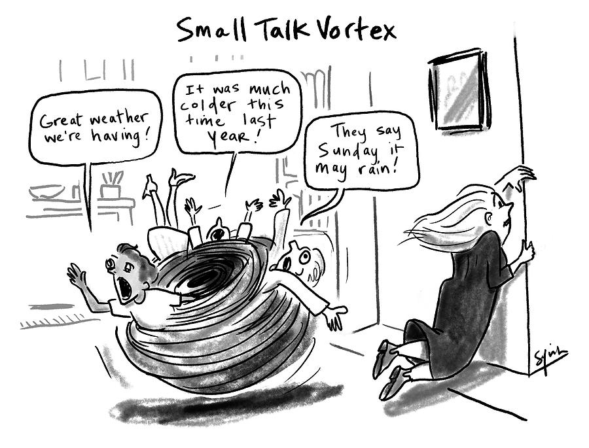
Small talk is important

Slide 6
Small talk is important
Most Chinese are more shy by nature than the average Westerner. Therefore, its important to take initiative. Your ultimate objective is to help the other person feel comfortable, eliminating any suspicion or awkwardness. Look for positive conversation topics. Chinese cuisine is always a winner; Chinese are universally passionate about their food, and love educating Westerners on the subject. After a few minutes of good small talk and a little laughter, you might shoot for a deeper connection.

Slide 7

The Chinese concept of Mianzi is important

Slide 8
The Chinese concept of Mianzi is important
It's extremely important to never make a person "lose face" by criticizing, ignoring, or making fun of them. What seems harmless to you may be terribly insulting to a Chinese person.

Slide 9

The definition of leadership varies greatly in China

Slide 10
The definition of leadership varies greatly in China
Western leadership, that is, the ability to guide, direct or influence people, is a concept that is quite foreign to the Chinese. In the eyes of Chinese, whoever has the authority or power automatically becomes the leader regardless of their ability to influence people...Such a person's leadership skills are not questioned--their position is respected, not their skills.

Slide 11

The Chinese almost never say no

Slide 12
The Chinese almost never say no
Generally speaking, Chinese communication is more indirect than English. Telling someone 'no' directly may seem disrespectful. Keeping in line with the concept of mianzi, many Chinese believe that saying 'no' to someone will make the other person lose 'face'. They don't want to show disrespect to you, your hard work, or your expertise, so they communicate in a more indirect style.

Slide 13
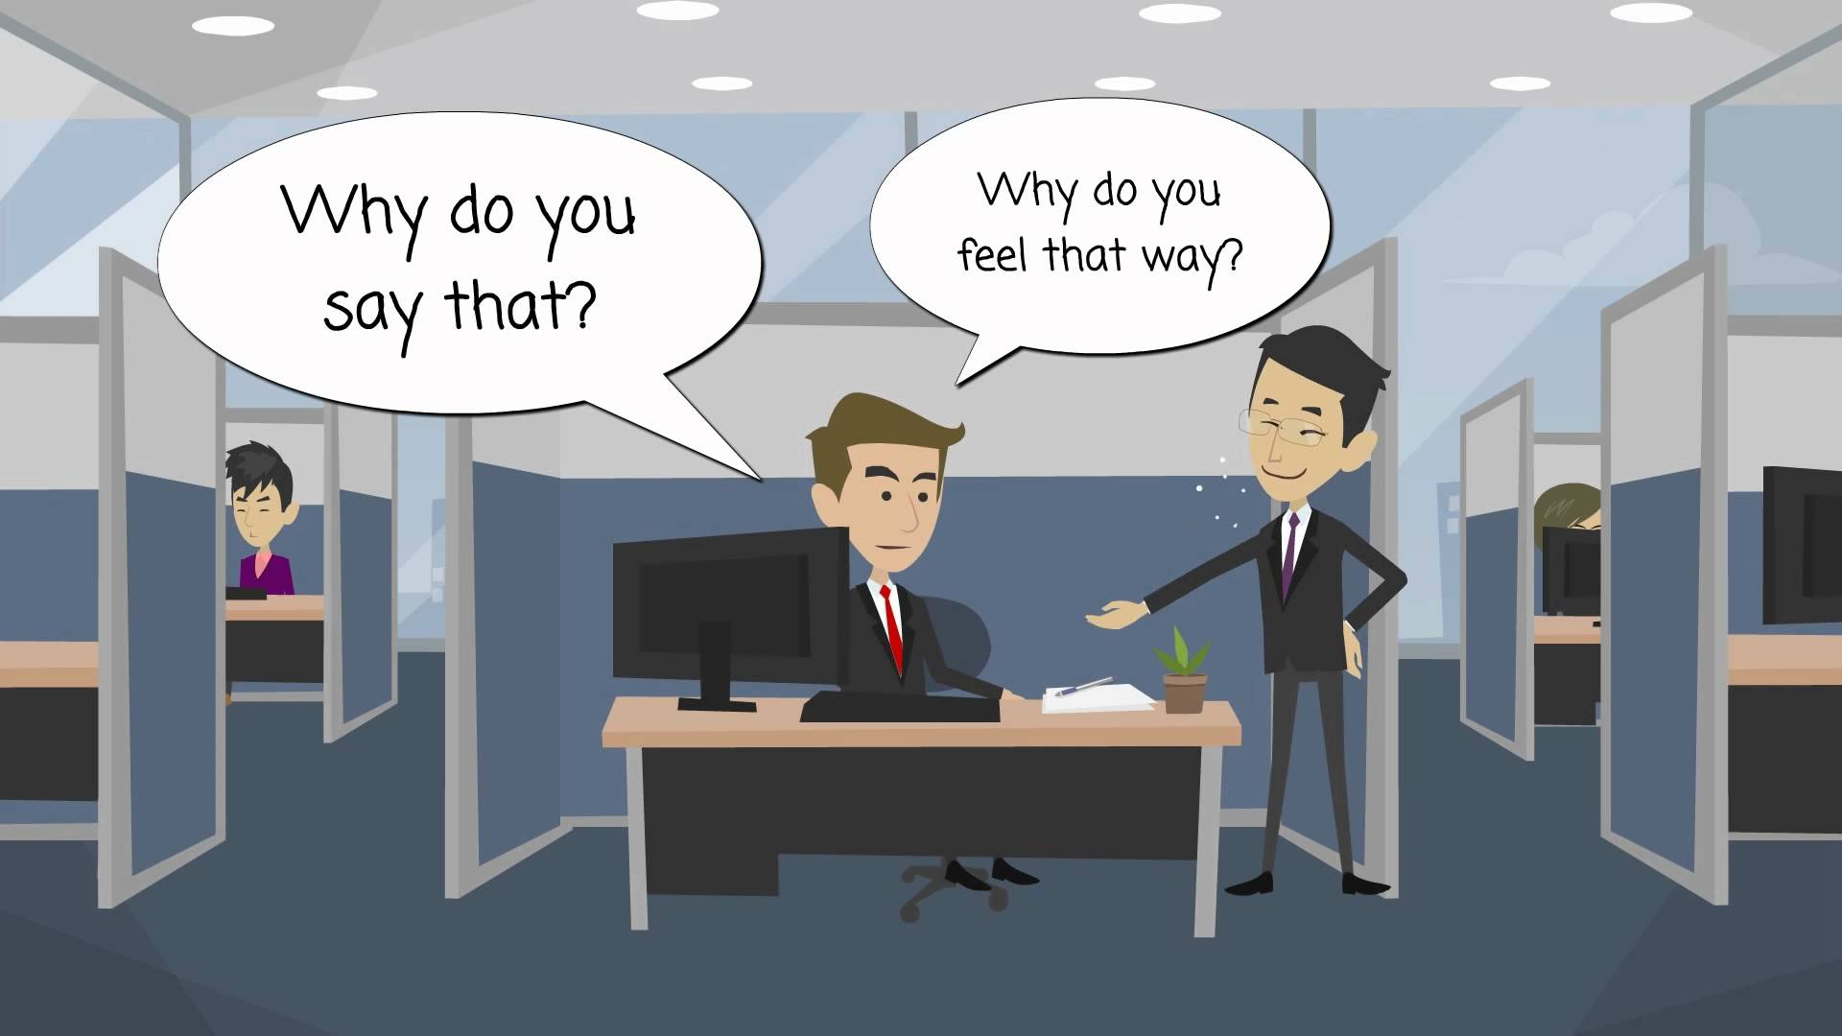
Understand which Chinese people you’re dealing with

Slide 14
Understand which Chinese people you’re dealing with
China is like a collection of diverse nations within a common economic boundary. Just like the British don't always see eye-to-eye with the French, similar regional differences exist in China. For example, people in Beijing are different in many ways to those in Shanghai. China is one of the most diverse countries in the world.

Slide 15

And that is what you need to know about doing business in china!

Slide 16

Source cited:
Bariso, Justin. “Going Global: 6 Things You Need to Know About Doing Business in China.” Inc.com, Inc., www.inc.com/justin-bariso/going-global-doing-business-in-china.html.

